Slide 1
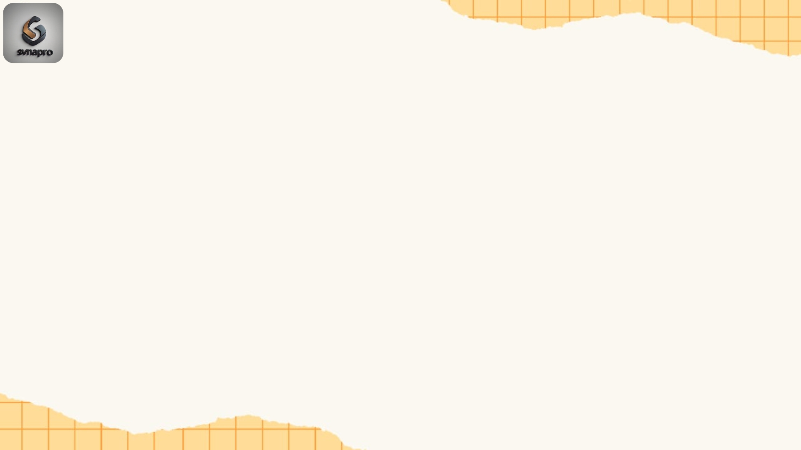
Introduction:
E-ComPredict: Customer Purchase Forecasting

Slide 2
Project Goal
The goal of this project is to predict whether a customer will purchase or not based on their session details (age, time spent, device type, discount applied, etc.).
Type of Problem → Supervised Machine Learning (Binary Classification).
Target Variable → purchase (0 = No, 1 = Yes).
Why important? → Businesses can target ads, optimize discounts, and improve sales by knowing which customers are most likely to buy.

Slide 3
Dataset Introduction: Realistic E-Commerce Dataset
This dataset simulates customer interactions on an e-commerce website.
Each row represents a customer session (one visit to the website).
The aim is to analyze user behavior and predict purchase decisions.
Shape:
Rows (records) → 1,200 sessions
Columns (features) → 25 attributes

Slide 4
Key Columns
Device & Browsing Info
device_type → Desktop / Mobile / Tablet
browser → Chrome, Firefox, Safari, Edge
time_of_day → Morning / Afternoon / Evening / Night
time_spent_minutes → total time spent on site
pages_viewed → number of pages browsed
scroll_depth → how far they scrolled (percentage)
clicks → number of clicks
Customer Info
user_id → unique customer ID
gender → Male / Female
age → customer age
location → country of customer
membership_status → Guest / Registered
returning_customer → 1 if returning, 0 if first time
Traffic & Marketing
traffic_source → Organic / Social / Referral / Paid
ad_campaign → Campaign_A / Campaign_B / Campaign_C
coupon_used → 1 if coupon used, 0 otherwise
discount_applied → 1 if discount applied, 0 otherwise

Slide 5
Key Columns
Shopping Behavior
product_category → Clothing, Electronics, Books, Sports, etc.
wishlist_items → number of items in wishlist
cart_items → number of items added to cart
avg_session_value → average monetary value of session ($)
payment_method → UPI / Debit Card / Credit Card / NetBanking / COD
Target Variable
purchase → 1 = Purchased
0 = Did Not Purchase

Slide 6
Exploratory Data Analysis (EDA)
Before building the model, we explored the dataset to understand patterns.
Demographics → Age distribution, gender split, customer locations.
Behavioral patterns → Time spent, pages viewed, clicks, wishlist/cart items.
Traffic sources → Organic, Social, Referral, Paid.
Effect of discounts/coupons → Did discounts increase purchase likelihood?
Purchase rate by device, membership, and campaign.

Slide 7
Data Preprocessing
Removed irrelevant columns (user_id, session_id, date).
Encoded categorical features (e.g., Gender → 0/1).
Standardized numerical values (scaling).
Split into training (80%) and testing (20%).
Saved feature names & scaler for deployment consistency.

Slide 8
Model Building
Algorithm Used → Random Forest Classifier.
Why? → Handles mixed data well, robust, and interpretable.
Trained model on preprocessed features.
Saved trained model (.pkl file) for reuse in deployment.
Model Evaluation
Metrics used: Accuracy, Precision, Recall, F1-score.
Confusion Matrix → shows true/false positives/negatives.
Business interpretation:
High recall → Good at catching all buyers.
High precision → Ensures predicted buyers are real buyers.

Slide 9
Random Forest Classifier
What is Random Forest?
Random Forest is a machine learning algorithm that builds many decision trees and combines them.
Each tree gives a prediction, and the forest takes a majority vote → this makes it more accurate and stable than a single tree.
Why Not a Single Decision Tree?
A single decision tree is easy to interpret, but:
It can overfit (memorize training data).
It is unstable → small data changes can change the whole tree.
Why Random Forest is Better
More accurate → because it averages multiple trees.
Less overfitting → because it uses random samples and features.
Handles mixed data → works well with both numbers and categories.
Robust → performs well on most datasets without heavy tuning.

Slide 10
Deployment (Streamlit)
Built an interactive web app using Streamlit.
Sidebar inputs → Users fill session details (age, device, time spent, etc.).
Model predicts:
Prediction → Will the customer purchase? (Yes/No).
Probability → Confidence (%) of purchase.
Deployed to Streamlit Cloud for public access.
Final Outcome
By the end of this project, students see the full journey:
From raw e-commerce data → insights (EDA) → ML model → deployed web app.
They learn both technical ML concepts and real-world application in business.

Slide 11
Implementation

Slide 12
Exploratory Data Analysis
Univariate Analysis → Examines the distribution of a single variable to understand its central tendency, spread, and patterns.
Bivariate Analysis → Explores relationships between two variables to find associations, correlations, or dependencies.
Multivariate Analysis → Investigates interactions among three or more variables simultaneously to uncover complex patterns.
Descriptive Statistics → Summarizes data with measures like mean, median, variance, and standard deviation.
Data Visualization → Uses plots (histogram, boxplot, scatter, heatmap) to make patterns and insights visually clear.

